Slide 1
How to write an abstract that catches everyone's attention
Johan Ludvig Brattås
Lead Solution Architect
Capgemini I&D Norway
johan-ludvig.brattas@capgemini.com
29.09.2021

Slide 2
Agenda
What is an abstract?
Who is it for?
The components of an abstract

Slide 3
So, what is an abstract?
A brief summary of your session
Also called précis or synopsis
It is your elevator pitch

Slide 4

Who is your abstract for?
3 target groups :
The program committee
The attendees
Yourself

Slide 5
The components of an abstract
Title
Blurb
Body
Goals
Additional information

Slide 6

Additional information
What level is your session?
100 – Introductory/ at a glance
200 – Slightly closer look
300 – Hands on details
400-500 – Expert level

Slide 7
Additional information
What level is your session?
Why is this important?
What audience do you want in your session?
Program committee balancing conference sessions
(Just be prepared – not all attendees reads session level …)

Slide 8

The goals
What do you hope the attendees will take from your session?
Not always in use, but useful as a planning tool for yourself

Slide 9

The body
Target group: Yourself
This is what my session will cover.
Why?
Abstract is written before session – but can help focus it.

Slide 10
The body
Target group: Program committee
Key considerations:
This is what my session will cover.
Why should you pick my session?
What kind of content are they looking for in their conference?
Think eye-catching key words

Slide 11
The body
Target group: Attendees
Key considerations:
Why should you go to my session?
This is what my session will cover.
Think eye-catching key words

Slide 12
The body
Never write too little, you need to ensure all key considerations are covered.
Humour can help (or not – but rarely hurts)
Get yourself a proof-reader. Does not have to be a techie.
Do you get your message across?

Slide 13
The body
Check your grammar!
Now check it again. Your proof-reader can help here.
Grammarly can be of great help – just be aware of the quirks…

Slide 14

The blurb
Not allways used
Condensed pitch of your session
Second most read part of a conference program

Slide 15
The blurb
Again – as with the body:
Always proof-read
Always check your grammar

Slide 16

The title
By far the most read part of a program
Attendees browse schedule, often picking session based on title.
Program committee might have to read through 100s of abstracts
The most important part of your abstract

Slide 17
The title
Remember, all target groups are most likely nerds…
Humour *can* work
Pop-cultural references *can* work

Slide 18
Additional information
Why is this important?
Your chance to add messages to the program committee outside of abstract – which will be made public.

Slide 19
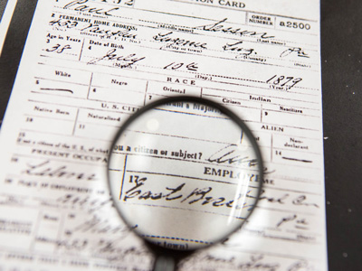
DISCLAIMER
There is of course no guarantee that a session will be picked, even after following all my advice…

Slide 20
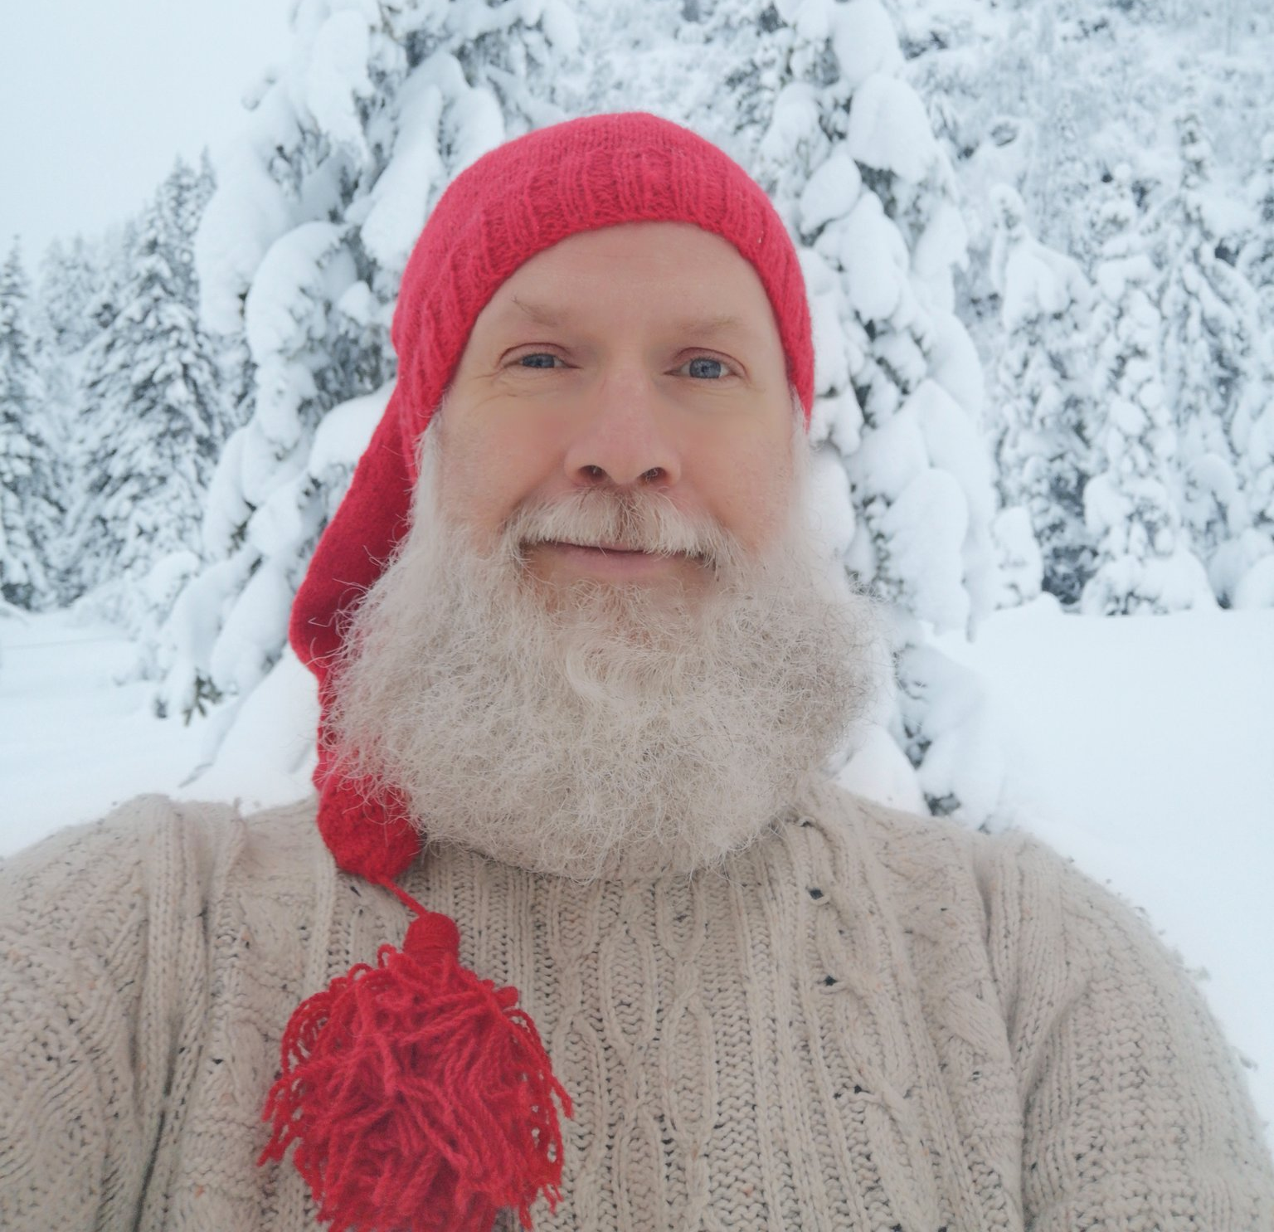


Chronic volunteer
Co-organizer – SQLSatOslo Ex Virtual Group lead – Excel BI Board member – MDPUG Oslo Frequent voulenteer in general for PASS
Lead Solutions Architect, Capgemini
When not geeking out over new tech
Teaching coeliacs how to bake gluten free Baking Hiking Gardening
/johanludvig
@intoleranse
johan-ludvig.brattas@capgemini.com

